Slide 1
Lesson 6: Exporting Results
6.1 Exporting Data
6.2 Exporting Reports

Slide 2
Lesson 6: Exporting Results
6.1 Exporting Data
6.2 Exporting Reports

Slide 3






SAS Programming Process
Access data
Explore data
Prepare data
Analyze and report on data
Export results
Notes:
We’ve reached the end of the process. We have clean data and accurate, interesting reports, so now we need to share what we have created with others. Not everyone who needs to view your results uses SAS, so we need methods to export data and reports in formats that will be easy to view outside SAS.

Slide 4
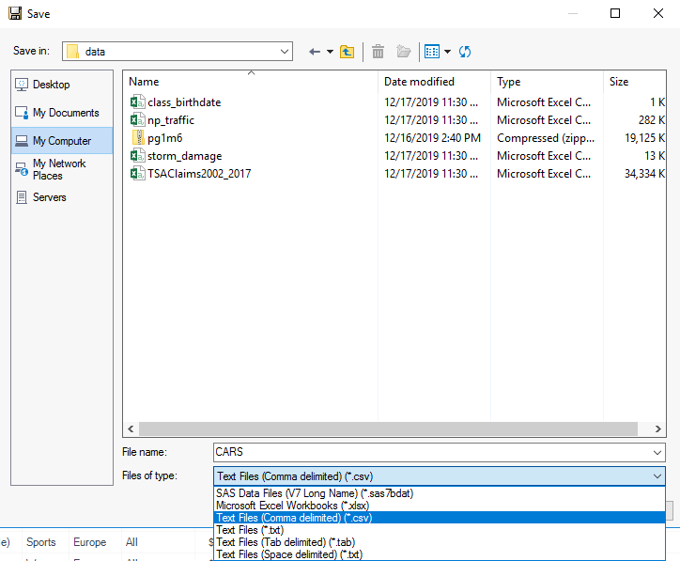
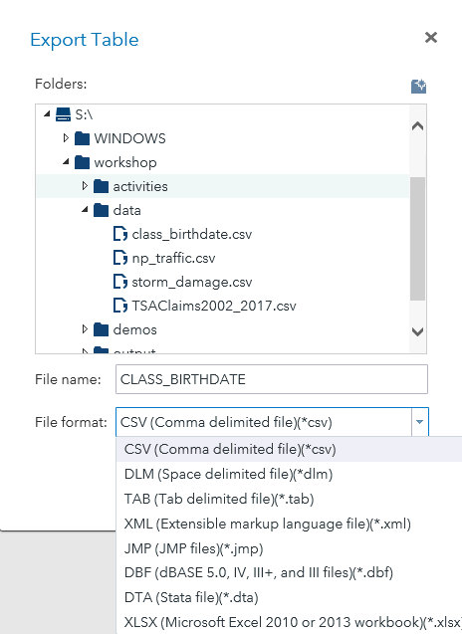
Exporting Data Using Point-and-Click Tools
Notes:
Let’s start with exporting data. If you want to export data using a manual process, each of the SAS programming environments includes point-and-click tools for exporting data to various delimited text formats, such as comma-separated values (CSV), tab-delimited values (TAB) and space-delimited (DLM) files. In Enterprise Guide, you can start this process by selecting Output Data from the Share option in the toolbar. In SAS Studio, you can right-click a table in the Library panel and select Export.

Slide 5
Exporting Data Using Code
PROC EXPORT DATA=input-table OUTFILE="output-file"
<DBMS=identifier> <REPLACE>;
RUN;
tells SAS how to format the output
Column names are automatically written as the first row of the output file.
Notes:
We are programmers. and there are several easy methods to programmatically export data, too. By writing a program to export data, you can easily integrate the export into your overall program to automate the final export step. This is SAS, so, of course, we have a PROC for that! PROC EXPORT can export a SAS table to a variety of external formats.
The DATA= option specifies the data source. The OUTFILE= option specifies the fully qualified path and file name of the exported data file. The DBMS= option tells SAS how to format the output. Several options are available here, including CSV, TAB, DLM, or XLSX. The REPLACE options tells SAS to overwrite the output if it already exists.

Slide 6
Exporting Data Using Code
proc export data=sashelp.cars
outfile="s:/workshop/output/cars.txt"
dbms=tab replace;
run;
Remember that the path is relative to the location of SAS.
Notes:
In this code example, PROC EXPORT creates a tab-delimited text file that has column names in the first row of the file. This is a good time for a reminder: the path that you put in the OUTFILE= option must be relative to the location of SAS. In other words, if SAS is running on a server, the path must be accessible from the server location.

Slide 7
6.01 Activity
Open the libname.sas program in the course files folder.
Create a macro variable named outpath that stores the location of the output folder in your course files location.
Run the code and save the program.
Notes:
Type answer here

Slide 8
6.01 Activity – Correct Answer
Open the libname.sas program in the course files folder.
Create a macro variable named outpath that stores the location of the output folder in your course files location.
Run the code and save the program.
%let outpath=s:/workshop/output;
Notes:
Type answer here

Slide 9
6.02 Activity
Open p106a02.sas from the activities folder and perform the following tasks:
Complete the PROC EXPORT step to read the pg1.storm_final SAS table and create a comma-delimited file named storm_final.csv. Use &outpath to substitute the path of the output folder.
Run the program and view the text file: SAS Studio – Navigate to the output folder in the navigation pane, right-click storm_final.csv, and select View File as Text. Enterprise Guide – Navigate to the output folder in the Servers pane, right-click storm_final.csv, and select Open.
Notes:
Type answer here

Slide 10
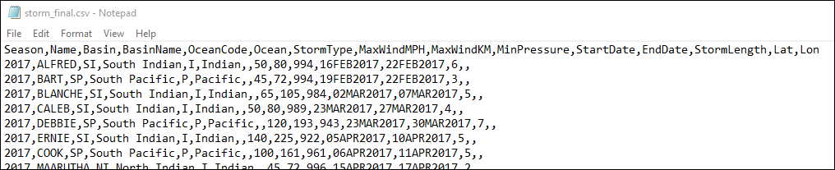
6.02 Activity – Correct Answer
proc export data=pg1.storm_final
outfile="&outpath/storm_final.csv"
dbms=csv;
run;
Notes:
Type answer here

Slide 11
Exporting Data with a LIBNAME Engine
libname myxl xlsx "&outpath/cars.xlsx";
data myxl.asiacars;
set sashelp.cars;
where origin='Asia';
run;
libname myxl clear;
defines a library to the Microsoft Excel workbook that you are creating
This code extracts data and writes it to the cars workbook on a tab named asiacars.
p106d01
Notes:
PROC EXPORT is simple, but another easy way to export data is to use a SAS/ACCESS Interface LIBNAME engine. We simply create the data in the desired format right from a SAS process. For example, a DATA step or procedure OUTPUT statement can write results directly to the target data source. I don’t have to create a SAS table first and then export the SAS table in a separate step. Of course, you need Write permission to the target destination.
As an example, this program uses the SAS/ACCESS Interface to PC File Formats XLSX engine to define a library to an Excel workbook named cars. The DATA step references the library and output worksheet named asiacars. The code extracts data about cars manufactured in Asia from sashelp.cars and writes the result directly into the worksheet asiacars.
Let's see what else we can do with this in a demo.

Slide 12
Exporting Data to an Excel Workbook
This demonstration illustrates using the XLSX LIBNAME engine to export SAS tables to multiple worksheets in an Excel workbook.
p106d01

Slide 13
6.03 Activity
Open p106a03.sas from the activities folder and perform the following tasks:
Complete the LIBNAME statement using the XLSX engine to create an Excel workbook named storm.xlsx in the output folder.
Modify the DATA step to write the storm_final table to the storm.xlsx file.
After the DATA step, write a statement to clear the library.
Run the program and view the log to confirm that storm.xlsx was exported with 3092 rows.
If possible, open the storm.xlsx file. How do dates appear in the storm_final workbook?
Notes:
Type answer here

Slide 14
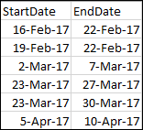
6.03 Activity – Correct Answer
libname xl_lib xlsx "&outpath/storm.xlsx";
data xl_lib.storm_final;
set pg1.storm_final;
drop Lat Lon Basin OceanCode;
run;
libname xl_lib clear;
Dates are automatically formatted.
Notes:
Type answer here

Slide 15
Lesson 6: Exporting Results
6.1 Exporting Data
6.2 Exporting Reports

Slide 16
Using the SAS Output Delivery System
SAS procedure
output object
ODS destinations
Notes:
We are programmers, and we want to build programs that can be run frequently and completely unattended. Fear not. SAS has the Output Delivery System (ODS), and it is programmable and flexible, making it simple to automate the entire process of exporting reports to other formats.
In SAS, procedures that generate reports really generate output objects, which can be rendered in one or more output formats designed to be viewed in SAS or in other software packages. In ODS terminology, each of these formats is called a destination. Some ODS destinations produce very simple output files, like text files conforming to comma-separated values standards. Others produce complex output files designed to be viewed and manipulated using external software packages. Common destinations of this type include Excel (XLSX), Microsoft Word (RTF), PowerPoint (PPTX), and Adobe (PDF), and there are many other destinations available in SAS.

Slide 17
Using the SAS Output Delivery System
ODS <destination> <destination-specifications>;
/* SAS code that produces output */
ODS <destination> CLOSE;
You can create different file types by changing the destination in the ODS statement.
Notes:
Directing output to these destinations is like making a sandwich. The SAS procedure code that creates the output is the “filling” for our sandwich, and the ODS statements preceding and following the output code is the “bread” that makes the output easy to consume outside of SAS. Let's take a look at how we can create various types of output just by changing the destinations in the ODS statement.

Slide 18
Exporting Output to a CSV File
ODS CSVALL FILE="filename.csv";
/* SAS code that produces output */
ODS CSVALL CLOSE;
CSVALL destination
ods csvall file="&outpath/cars.csv";
proc print data=sashelp.cars noobs;
var Make Model Type MSRP MPG_City MPG_Highway;
format MSRP dollar8.;
run;
ods csvall close;
Notes:
First let's export our report to a CSV file by using the CSVALL destination. You've see that you can use PROC EXPORT to create a CSV file, so how is this different?

Slide 19
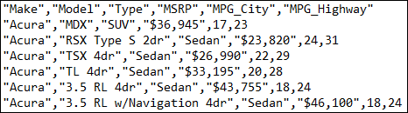
Exporting Output to a CSV File
ods csvall file="&outpath/cars.csv";
proc print data=sashelp.cars noobs;
var Make Model Type MSRP MPG_City MPG_Highway;
format MSRP dollar8.;
run;
ods csvall close;
Using ODS CSVALL with PROC PRINT enables you to specify the order and format of columns in the CSV file.
Notes:
By using ODS CSVALL with PROC PRINT, you can specify the order and format of the columns in your output CSV file.

Slide 20
Exporting Results to Excel
ODS EXCEL FILE="filename.xlsx" STYLE=style
OPTIONS(SHEET_NAME='label');
/* SAS code that produces output */
ODS EXCEL CLOSE;
By default, the results from each procedure are on separate worksheets in the Excel file.
Notes:
Now let's export our report to that ubiquitous destination: Excel. The ODS EXCEL destination provides an enormous amount of flexibility, so this is a good chance for us to try out a few of the many options that are available.
You can specify a style for the output by using the STYLE= option. There are many different styles that are built in to SAS. You can list additional options in the ODS statement by using the OPTIONS keyword and enclosing option-value pairs in parentheses. The SHEET_NAME option customizes the tab names in the workbook.

Slide 21
Exporting Results to Excel
This demonstration illustrates using the ODS EXCEL destination to export reports to multiple worksheets in an Excel workbook.
p106d02

Slide 22
6.04 Activity
Open p106a04.sas from the activities folder and perform the following tasks:
Add ODS statements to create an Excel file named pressure.xlsx in the output folder. Be sure to close the ODS location at the end of the program. Run the program and open the Excel file. SAS Studio: Navigate to the output folder in the Files and Folders section of the navigation pane. Select pressure.xlsx and click Download . Enterprise Guide: Click the Results tab. Then, under Open with Default Application, double-click the Excel icon.
Add the STYLE=ANALYSIS option in the first ODS EXCEL statement. Run the program again and open the Excel file.
Notes:
Type answer here

Slide 23
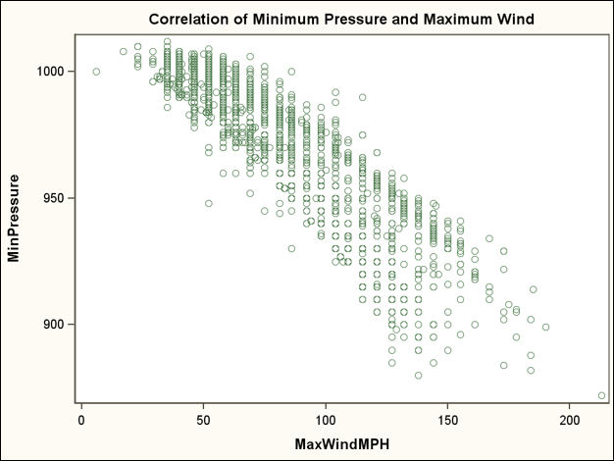
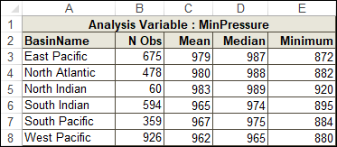
6.04 Activity – Correct Answer
ods excel file="&outpath/pressure.xlsx" style=analysis;
title "Minimum Pressure Statistics by Basin";
ods noproctitle;
...
ods excel close;
Notes:
Type answer here

Slide 24
Exporting Output to PowerPoint and Microsoft Word
ODS POWERPOINT FILE="filename.pptx" STYLE=style;
/* SAS code that produces output */
ODS POWERPOINT CLOSE;
RTF files can be read by word processing software such as Microsoft Word.
ODS RTF FILE="filename.rtf" STARTPAGE=NO;
/* SAS code that produces output */
ODS RTF CLOSE;
Notes:
The Output Delivery System also enables us to export reports to common formats that we use in everyday business, such as PowerPoint by using the Powerpoint destination, and Microsoft Word by using the RTF destination. The Rich Text Format (RTF) destination is a software-agnostic file type that’s made for word processing programs such as Microsoft Word. There are particular options that apply to each of these destinations so that you can customize your output.

Slide 25
6.05 Activity
Open p106a05.sas from the activities folder and perform the following tasks:
Run the program and open the pressure.pptx file.
Modify the ODS statements to change the output destination to RTF. Change the style to sapphire.
Add the STARTPAGE=NO option in the first ODS RTF statement to eliminate a page break between the procedure results.
Rerun the program and open the pressure.rtf file.
Notes:
Type answer here

Slide 26
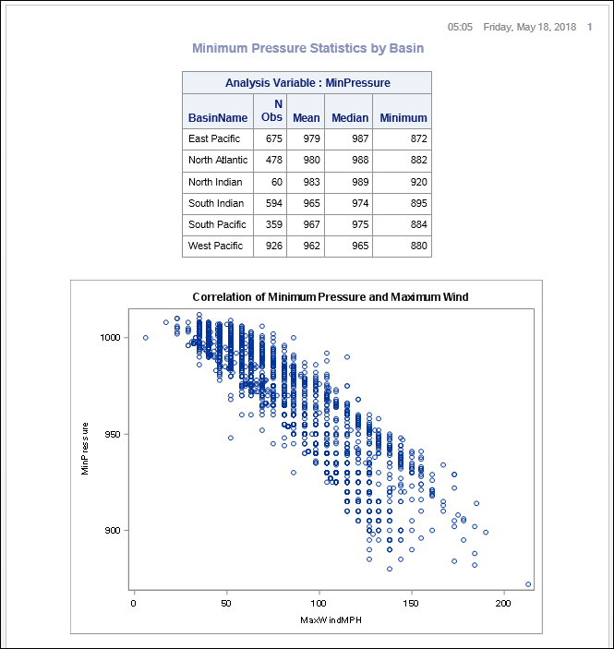
6.05 Activity – Correct Answer
ods rtf file="&outpath/pressure.rtf" style=sapphire
startpage=no;
title "Minimum Pressure Statistics by Basin";
ods noproctitle;
...
ods rtf close;
The STARTPAGE= option controls page breaks in the file.
Notes:
Type answer here

Slide 27
Exporting Results to PDF
ODS PDF FILE="filename.pdf" STYLE=style
STARTPAGE=NO PDFTOC=n;
ODS PROCLABEL "label";
/* SAS code that produces output */
ODS PDF CLOSE;
The PDF destination has many options for specifying the layout and appearance of your output file.
Notes:
Finally, let’s take a look at the Portable Document Format (PDF) destination. We use PDF files extensively for reporting because the layout can be precisely controlled, and we can guarantee that the document will look just as we intended it to when the receiver opens it with the appropriate rendering software.
In SAS ODS, PDF is one of the PRINTER destinations, meaning you have a lot of programmatic control over the document’s appearance if you want to spend the time to become an expert with ODS PDF. Again, we won't learn about all the options that are available but we will explore a few.
We'll use the PDFTOC= option to control the level of bookmarks that are open. We'll use the ODS PROCLABEL statement to label the bookmark for the procedure. Let's see how all this works together to create a PDF.

Slide 28
Exporting Results to PDF
This demonstration illustrates using the ODS PDF destination to export reports to a PDF file.
p106d03

Slide 29
Beyond SAS Programming 1
What if you want to ...
. . . learn more about working with SAS and Excel?
. . . look up additional options for exporting data or results?
. . . learn to create and customize reports with ODS?
Take the Exporting SAS Data Sets and Creating ODS Files for Microsoft Excel course.
View the following Help pages:
Base SAS EXPORT procedure
SAS Output Delivery System: User’s Guide
SAS/ACCESS Interface to PC Files: Reference
Take the SAS Report Writing 1: Essentials course.
Explore the SAS Output Delivery System resource page.

Slide 30
Practice
This practice reinforces the concepts discussed previously.

Slide 31
Lesson Quiz

Slide 32
Which statement is false concerning the options for the PROC EXPORT statement?
The DATA= option identifies the input SAS table.
The REPLACE option specifies to overwrite an existing file.
The DBMS= option specifies the database identifier for the type of file being created.
The OUT= option specifies the path and file name of the external data file being created.
Notes:
Correct answer: d
The OUTFILE= (not OUT=) option specifies the path and filename of the external data file being created.

Slide 33
Which statement is false concerning the options for the PROC EXPORT statement?
The DATA= option identifies the input SAS table.
The REPLACE option specifies to overwrite an existing file.
The DBMS= option specifies the database identifier for the type of file being created.
The OUT= option specifies the path and file name of the external data file being created.
Notes:
Correct answer: d
The OUTFILE= (not OUT=) option specifies the path and filename of the external data file being created.

Slide 34
Which PROC EXPORT step contains valid syntax?
.
.
.
.
proc export outfile="c:\temp\cars.txt" tab
data=sashelp.cars replace; run;
proc export data=sashelp.cars dbms=csv
outfile="c:\temp\cars.csv"; run;
proc export data=sashelp.class; dbms=csv;
outfile="c:\temp\cars.csv"; run;
proc export dbms=tab data=sashelp.cars replace=yes
outfile="c:\temp\cars.txt"; run;
Notes:
Correct answer: b
DATA=, DBMS=, and OUTFILE= are valid PROC EXPORT options. For a, DBMS= is missing in front of TAB. For c, there shouldn’t be semi-colons after each option. For d, =YES is not valid after REPLACE.

Slide 35
Which PROC EXPORT step contains valid syntax?
.
.
.
.
proc export outfile="c:\temp\cars.txt" tab
data=sashelp.cars replace; run;
proc export data=sashelp.cars dbms=csv
outfile="c:\temp\cars.csv"; run;
proc export data=sashelp.class; dbms=csv;
outfile="c:\temp\cars.csv"; run;
proc export dbms=tab data=sashelp.cars replace=yes
outfile="c:\temp\cars.txt"; run;
Notes:
Correct answer: b
DATA=, DBMS=, and OUTFILE= are valid PROC EXPORT options. For a, DBMS= is missing in front of TAB. For c, there shouldn’t be semi-colons after each option. For d, =YES is not valid after REPLACE.

Slide 36
What does the following program create?
two SAS tables: sales.q1_2018 and sales.q2_2018
two Excel workbooks: sales.q1_2018 and sales.q2_2018
two worksheets in the Excel workbook: midyear: q1_2018 and q2_2018
two worksheets in the Excel workbook: sales: q1_2018 and q2_2018
libname sales xlsx 'c:\mydata\midyear.xlsx';
data sales.q1_2018;
set sasdata.qtr1_2018;
run;
data sales.q2_2018;
set sasdata.qtr2_2018;
run;
Notes:
Correct answer: c
The LIBNAME specifies the Excel workbook MIDYEAR. The DATA statements reference to create the worksheets Q1_2018 and Q2_2019 within the workbook MIDYEAR. The library reference of SALES is what links the LIBNAME and DATA statements.

Slide 37
What does the following program create?
two SAS tables: sales.q1_2018 and sales.q2_2018
two Excel workbooks: sales.q1_2018 and sales.q2_2018
two worksheets in the Excel workbook: midyear: q1_2018 and q2_2018
two worksheets in the Excel workbook: sales: q1_2018 and q2_2018
libname sales xlsx 'c:\mydata\midyear.xlsx';
data sales.q1_2018;
set sasdata.qtr1_2018;
run;
data sales.q2_2018;
set sasdata.qtr2_2018;
run;
Notes:
Correct answer: c
The LIBNAME specifies the Excel workbook MIDYEAR. The DATA statements reference to create the worksheets Q1_2018 and Q2_2019 within the workbook MIDYEAR. The library reference of SALES is what links the LIBNAME and DATA statements.

Slide 38
Which statement disassociates the sales libref?
libname sales end;
libname sales clear;
libname sales close;
libname sales disassociate;
libname sales xlsx 'c:\mydata\midyear.xlsx';
Notes:
Correct answer: b
The CLEAR option on the LIBNAME statement disassociates one or more currently assigned librefs..

Slide 39
Which statement disassociates the sales libref?
libname sales end;
libname sales clear;
libname sales close;
libname sales disassociate;
libname sales xlsx 'c:\mydata\midyear.xlsx';
Notes:
Correct answer: b
The CLEAR option on the LIBNAME statement disassociates one or more currently assigned librefs..

Slide 40
What type of output file does this program create?
SAS table
delimited file
Microsoft Excel XLS file
Microsoft Excel XLSX file
libname mylib xlsx "s:/workshop/output/test.xlsx";
data class_list;
set sashelp.class;
run;
Notes:
Correct answer: a
The DATA statement references CLASS_LIST. A libref is not specified so WORK is assumed. WORK.CLASS_LIST is a temporary SAS table.

Slide 41
What type of output file does this program create?
SAS table
delimited file
Microsoft Excel XLS file
Microsoft Excel XLSX file
libname mylib xlsx "s:/workshop/output/test.xlsx";
data class_list;
set sashelp.class;
run;
Notes:
Correct answer: a
The DATA statement references CLASS_LIST. A libref is not specified so WORK is assumed. WORK.CLASS_LIST is a temporary SAS table.

Slide 42
Which of these programs creates a Microsoft Excel file?
.
.
both
neither
ods excel file="s:/workshop/output/class.xlsx";
proc print data=sashelp.class;
run;
ods excel close;
libname mylib xlsx "s:/workshop/output/class.xlsx";
data mylib.class_list;
set sashelp.class;
run;
Notes:
Correct answer: c
Both, ODS EXCEL and the LIBNAME with XLSX engine create Excel workbooks.

Slide 43
Which of these programs creates a Microsoft Excel file?
.
.
both
neither
ods excel file="s:/workshop/output/class.xlsx";
proc print data=sashelp.class;
run;
ods excel close;
libname mylib xlsx "s:/workshop/output/class.xlsx";
data mylib.class_list;
set sashelp.class;
run;
Notes:
Correct answer: c
Both, ODS EXCEL and the LIBNAME with XLSX engine create Excel workbooks.

Slide 44
Which of the following is not a valid ODS statement?
ods csvall file='c:\temp\myfile.csv';
ods pdf file='c:\temp\myfile.pdf';
ods powerpoint file='c:\temp\myfile.ppt';
ods word file='c:\temp\myfile.doc';
Notes:
Correct answer: d
WORD is not a valid destination for the ODS statement. The RTF destination will create a file that can be opened by word processors. ods rtf file='c:\temp\myfile.rtf';

Slide 45
Which of the following is not a valid ODS statement?
ods csvall file='c:\temp\myfile.csv';
ods pdf file='c:\temp\myfile.pdf';
ods powerpoint file='c:\temp\myfile.ppt';
ods word file='c:\temp\myfile.doc';
Notes:
Correct answer: d
WORD is not a valid destination for the ODS statement. The RTF destination will create a file that can be opened by word processors. ods rtf file='c:\temp\myfile.rtf';

Slide 46
What statement needs to be added to the end of this program?
ods clear;
ods close;
ods pdf clear;
ods pdf close;
ods pdf file='c:\temp\myfile.pdf’;
proc print data=sashelp.class;
run;
Notes:
Correct answer: d
The CLOSE argument closes the destination and the file that is associated with it.

Slide 47
What statement needs to be added to the end of this program?
ods clear;
ods close;
ods pdf clear;
ods pdf close;
ods pdf file='c:\temp\myfile.pdf’;
proc print data=sashelp.class;
run;
Notes:
Correct answer: d
The CLOSE argument closes the destination and the file that is associated with it.

Slide 48
Which statement is false concerning the options for the ODS statement?
The STYLE= option names the desired font.
The FILE= option specifies the output file to create.
The STARTPAGE= option controls the behavior of page breaks.
The PDFTOC= option controls the level of the expansion of the table of contents in PDF documents.
Notes:
Correct answer: a
The STYLE= option names the style to use in the output file. The style controls visual aspects such as colors and fonts.

Slide 49
Which statement is false concerning the options for the ODS statement?
The STYLE= option names the desired font.
The FILE= option specifies the output file to create.
The STARTPAGE= option controls the behavior of page breaks.
The PDFTOC= option controls the level of the expansion of the table of contents in PDF documents.
Notes:
Correct answer: a
The STYLE= option names the style to use in the output file. The style controls visual aspects such as colors and fonts.

Slide 50
Which statement contains valid syntax for specifying a worksheet name?
ods excel sheet_name='Males';
ods excel (sheet_name='Males');
ods excel option(sheet_name='Males');
ods excel options(sheet_name='Males');
Notes:
Correct answer: d
SHEET_NAME= is a sub-option that goes in a set of parentheses for the OPTIONS option.

Slide 51
Which statement contains valid syntax for specifying a worksheet name?
ods excel sheet_name='Males';
ods excel (sheet_name='Males');
ods excel option(sheet_name='Males');
ods excel options(sheet_name='Males');
Notes:
Correct answer: d
SHEET_NAME= is a sub-option that goes in a set of parentheses for the OPTIONS option.

